Slide 1
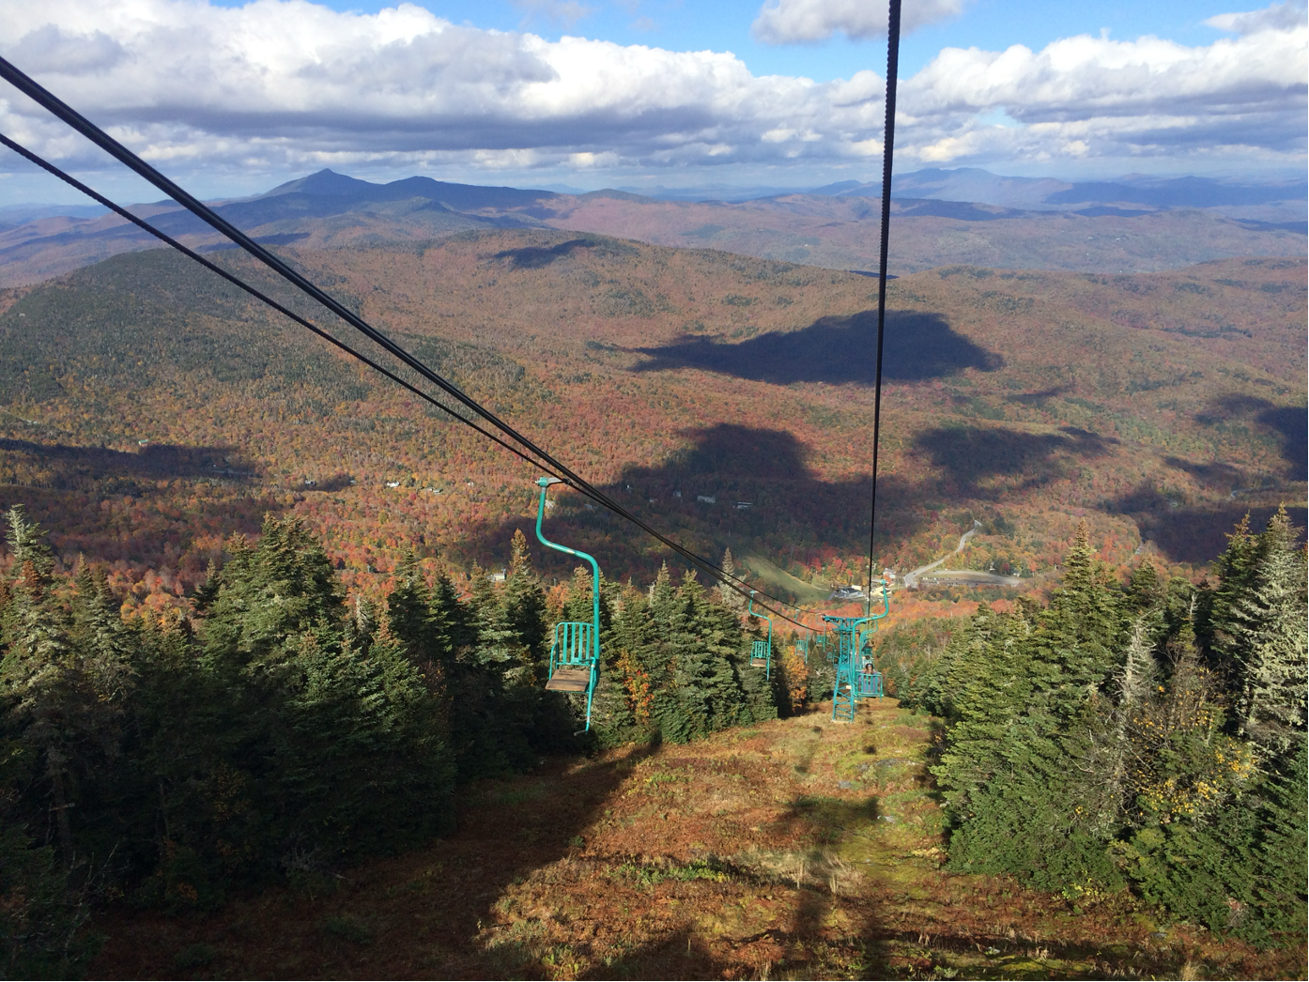
Mad River Valley Planning District
2025 Workplan
2025 Annual Data Report
2026 Wellbeing Survey
4/7/2026
Waitsfield Planning Commission

Slide 2

Joshua Schwartz, Executive Director
Franni Hoag, Community Planner
Union Municipal District
Serving Waitsfield, Warren, & Fayston
MRV Vision Statement:
The Mad River Valley is an innovative, vibrant, connected, and caring community, honoring its past, celebrating its landscape, and actively pursuing its potential.

Slide 3
MRVPD: Waitsfield, Warren, Fayston
Goal: collect, synthesize, frame, and share data with decision makers & public
Focus: planning, housing, economic development, conservation, recreation, infrastructure, transportation, historic preservation
Steering Committee:
Selectboard member & Planning Commission member from each town
Chamber of Commerce, Sugarbush, & CVRPC
Meeting: 3rd Thursday of every Month, 7pm @ Waitsfield Town Office

Slide 4
FY27 MRVPD Workplan (March 26 – February 2027)
Infrastructure
Waitsfield Wastewater Planning Project Coordination
Support municipal town garage efforts
Data
Develop 2026 MRV Data Report
Conduct MRV Wellbeing Survey
Update MRV Community Dashboard
Housing
Support Warren Short-Term Rental Data Project
Support Waitsfield Short-Term Rental Exploration
Transportation
Collaborate on the design and construction of the Sugarbush Access Rd. Shared-Use Path
Support MRV bus service transition
Support VT 100 traffic calming in Warren
Conservation
FMR Collaboration on Response, Rebuild, & Resilience Efforts
Community Recreation Visioning 2.0
Rural Resources
Coordinate MRV Rural Resources Commission
Sugarbush
Provide project review and guidance on Sugarbush projects
Municipal Support
Zoning Administrator meetings & support
Tri-Town Leadership Meeting/40th Anniversary
Organizational
MRVPD Administration
Communication/Outreach
Update Personnel Policies
Delineation
Both
Josh
Franni
Notes:
Created this work plan prior to Franni joining. 5 weeks in, revisited the workplan to clarify strategy – details, responsibility (who), and timing.
Some items require additional discussions before all details come into focus, so heads up that some are still evolving

Slide 5
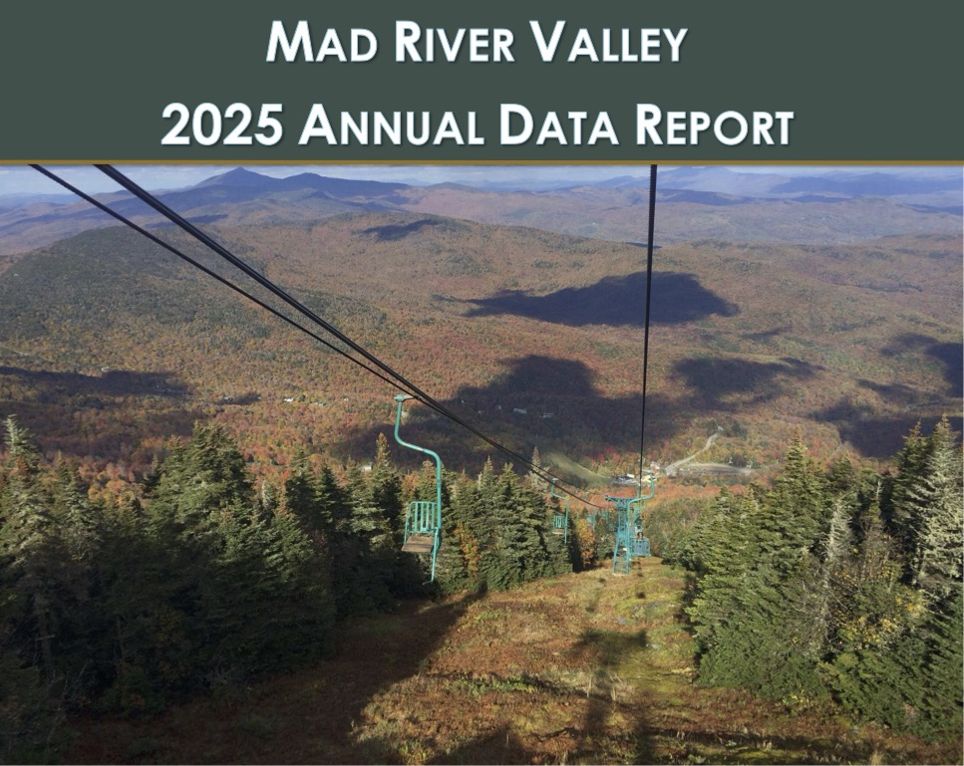
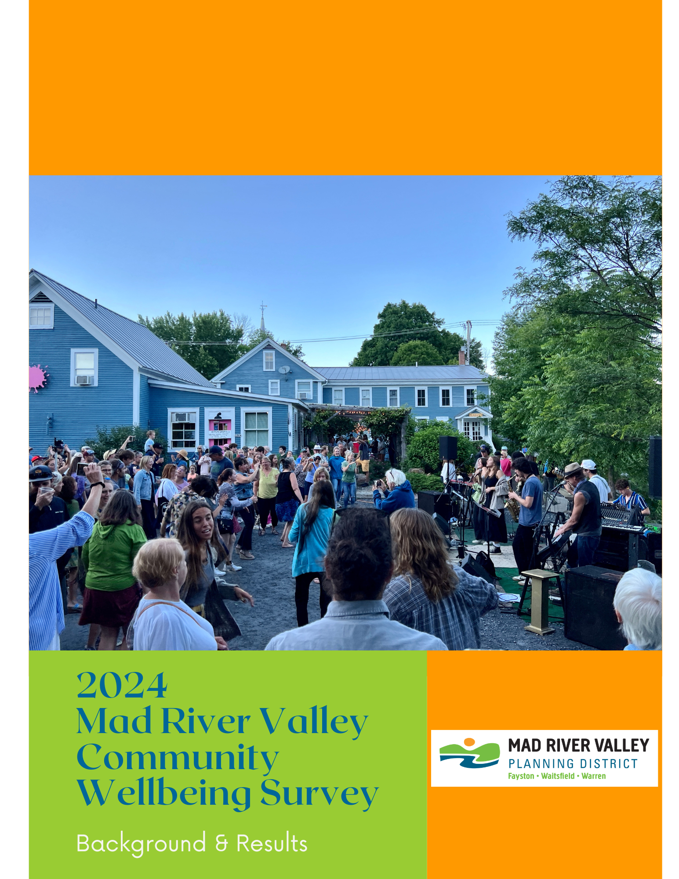
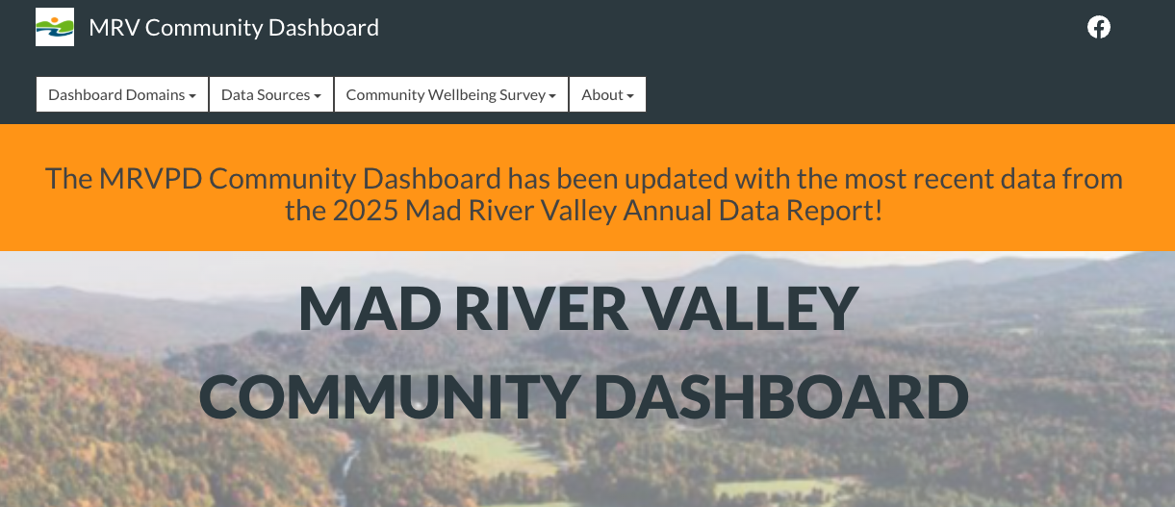
Data Report:
Annual
Online: PDF
Print
Mostly Quantitative
Housing, Economic Development, Employment, Conservation, Infrastructure, Traffic, Transit & more
Community Wellbeing Survey:
Biannual
Online: PDF
Print
Mostly Qualitative
Wellbeing, Health, Life Satisfaction, Governance, Community goals, & more
Community Dashboard:
Online & Interactive

Slide 6
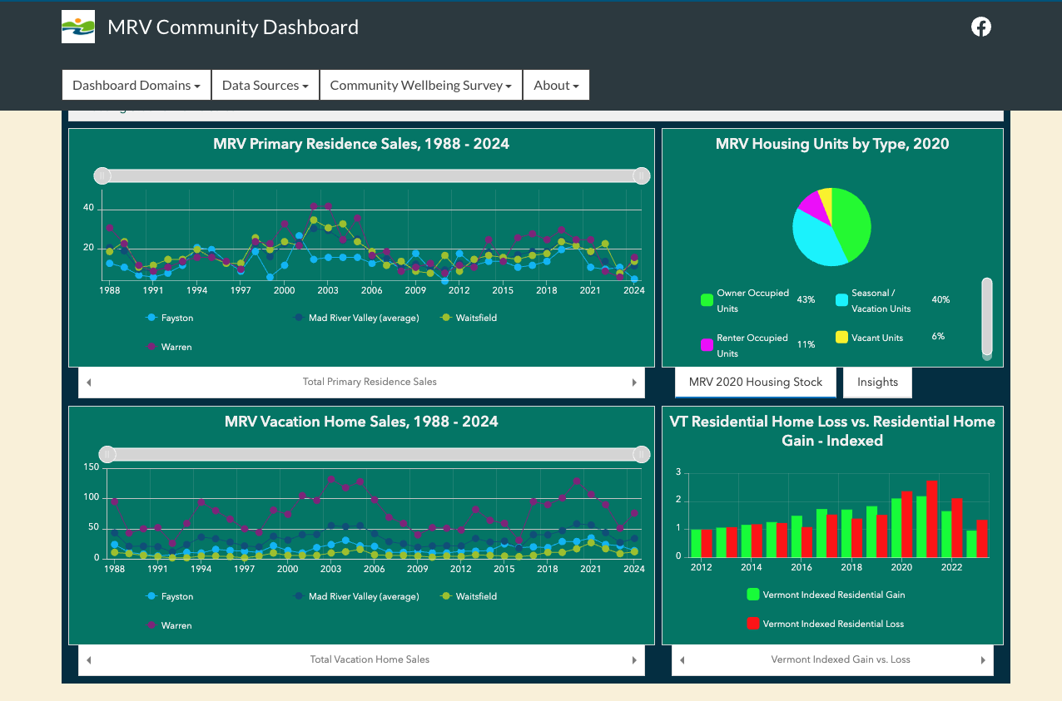

Slide 8

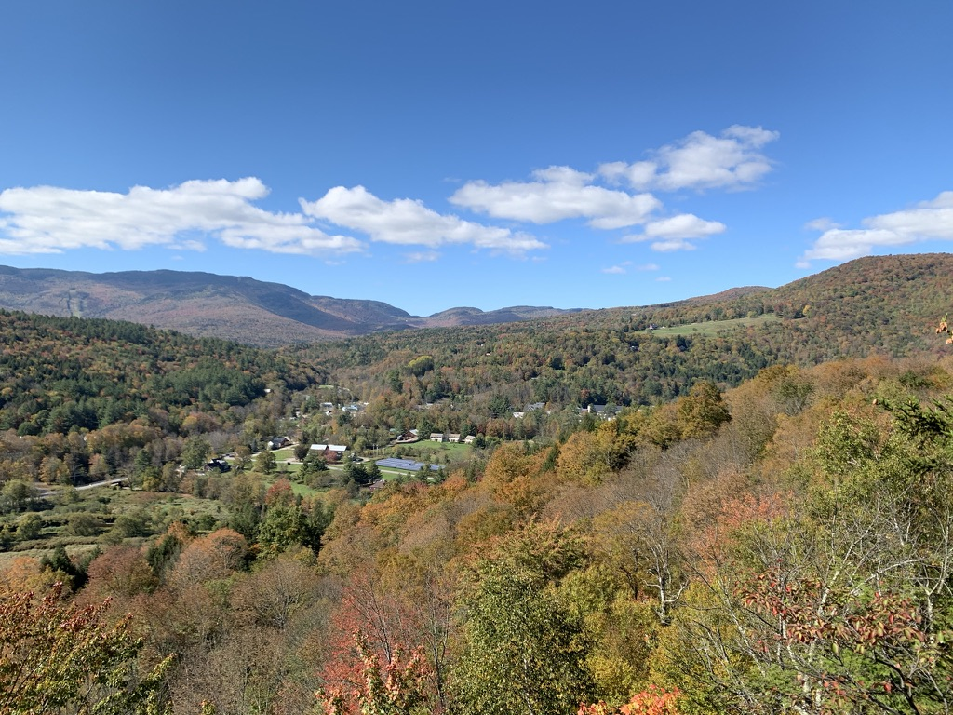
Age & Population – Recent Trends
4,600 - 5,100 people live in the Valley
Average Age has increased
School enrollment is down across HUUSD

Slide 9
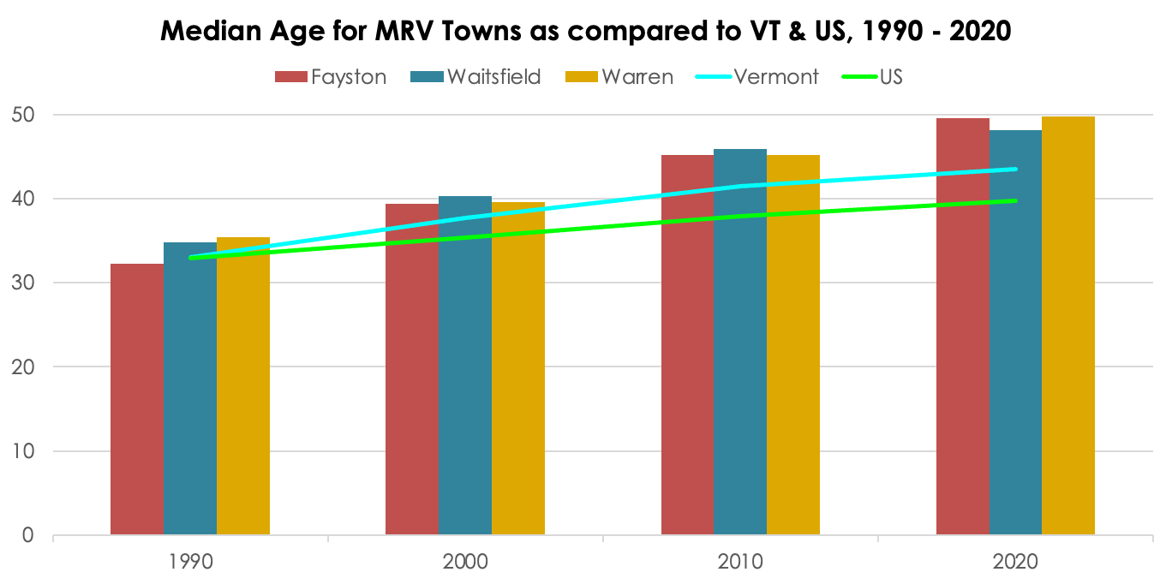
Trending older than VT and the US as a whole…
Figure 8, page 14

Slide 10
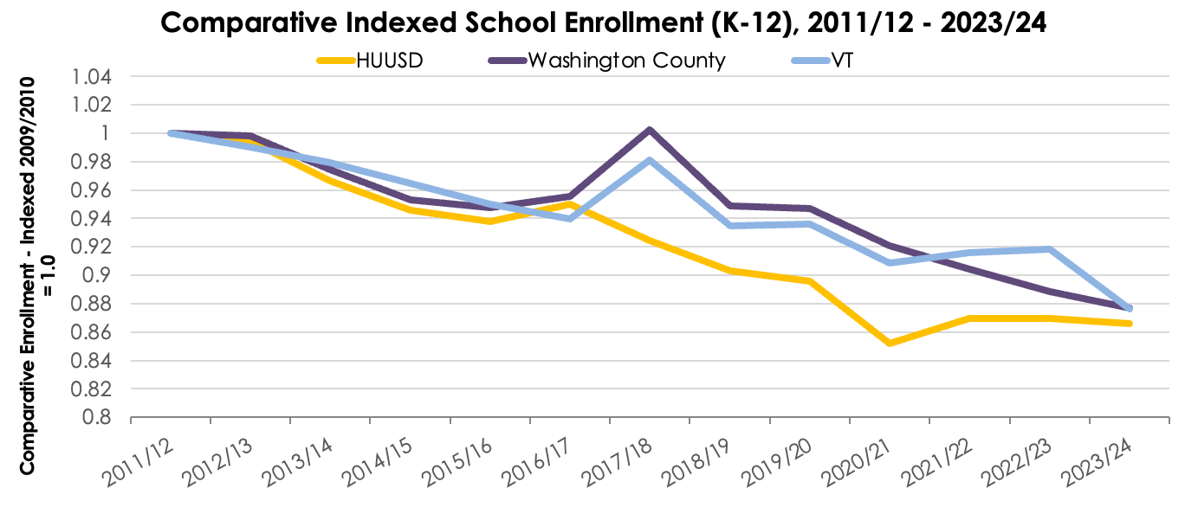
School enrollment has declined 8% in VT since 2011/12; 13% in the MRV
MRV Elementary & Middle School class sizes were 1-7% below district average
MRV High School class sizes were 9% - 13% below district average
Figure 5, page 11

Slide 11
Housing – Recent Trends
Sales of primary & vacation homes: decreased since 2020
Price of primary & vacation homes has increased
# of active short-term rental units increased
Rent in Waitsfield is in line with county & statewide trends; rent in Warren has recently increased

Slide 12
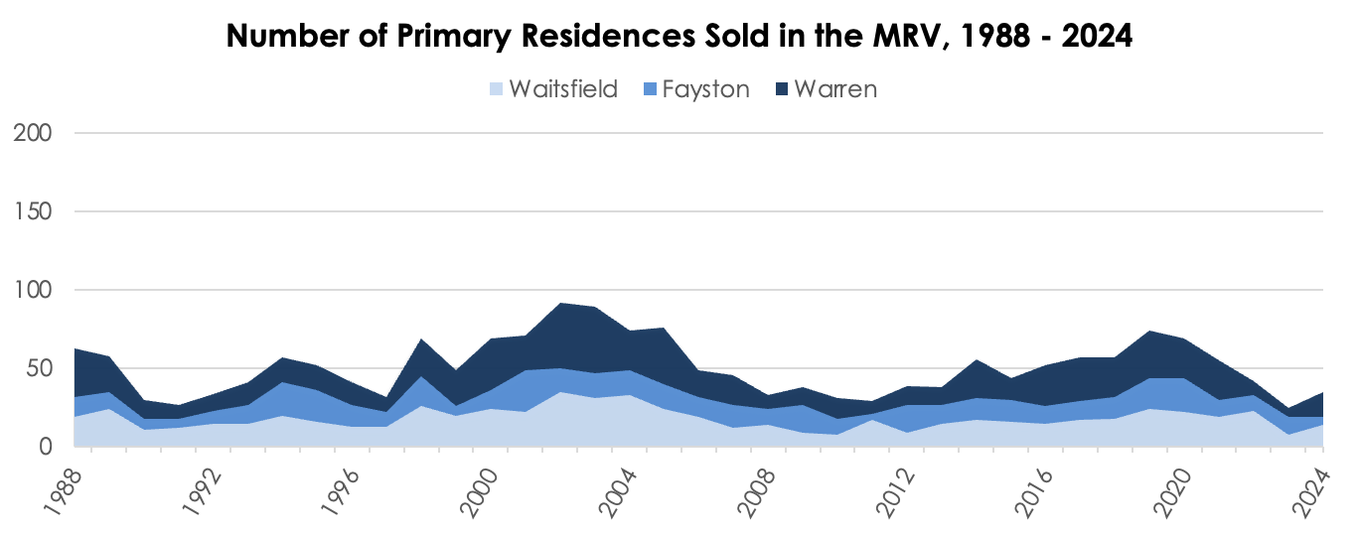
2011 - 2019: annual primary home sales increased from 29 to 74 (115% increase)
MRV, 2020 - 2024: annual home sales decreased by 53%
Figure 18, page 24

Slide 13
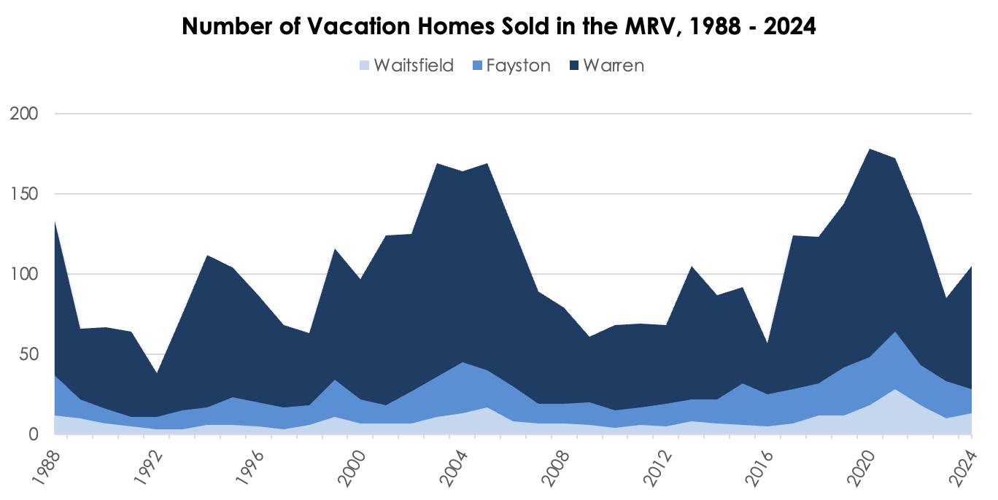
Vacation home sales:
increased by 153% between 2012 – 2020
decreased by 39% from 2021 – 2024
Figure 20, page 26

Slide 14
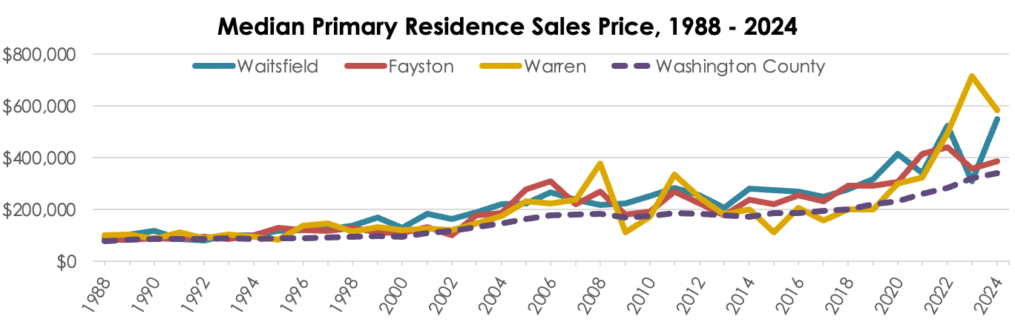
Between 2013 and 2023, the median primary residence sales price increased by:
50% in Waitsfield
101% in Fayston
297% in Warren
Regional trends: 80% increase in Washington County, 63% increase statewide.
Figure 24, page 30

Slide 15
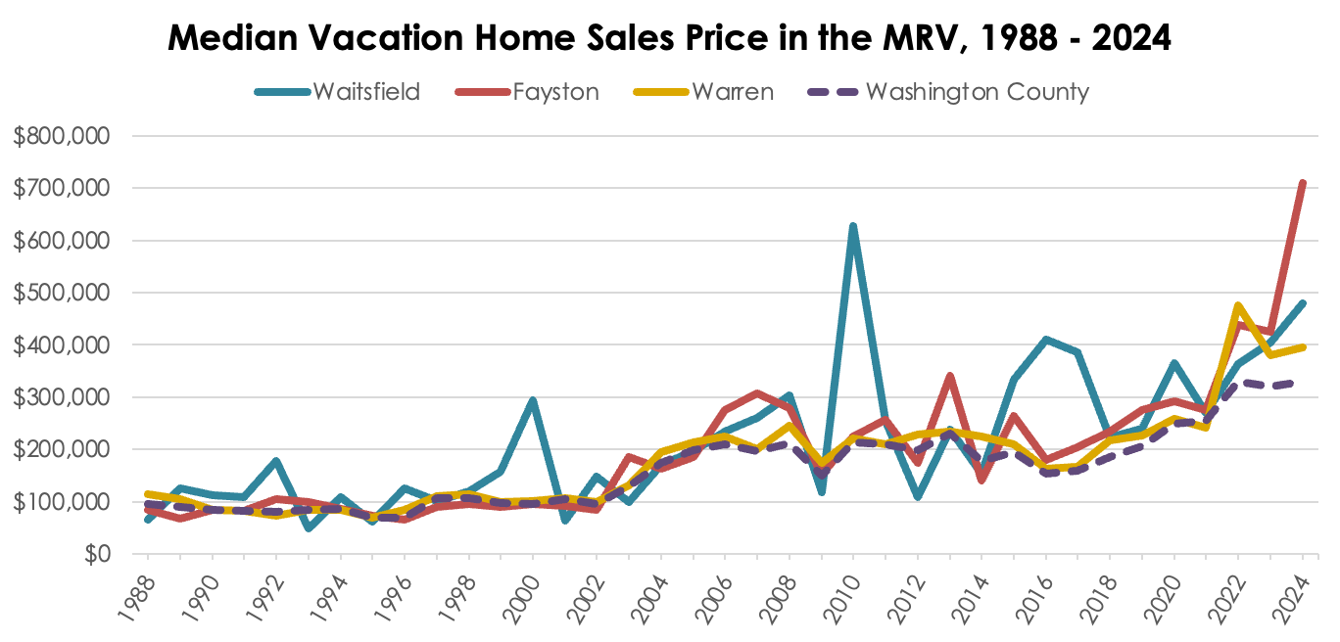
2016 - 2024: median sale price for vacation homes rose by:
142% in Warren, 294% in Fayston, and 17% in Waitsfield.
Figure 25, page 31

Slide 17
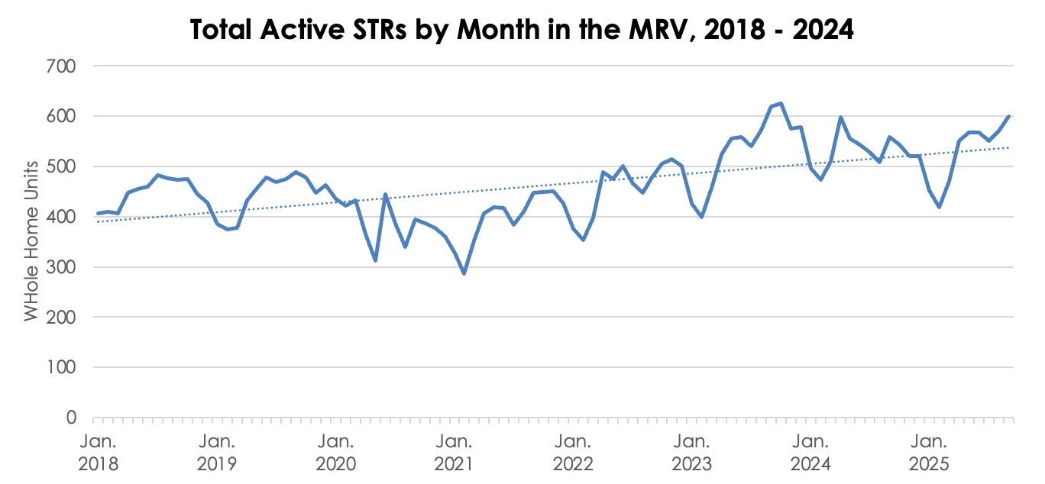
Short-term rentals – cyclical, trending upwards
Figure 33, page 39

Slide 18

Economics – Recent Trends
Meals, Rooms, and Alcohol receipts:
Recovery from COVID downturn
MRV’s Meals, Rooms, and Alcohol receipts still outpace Montpelier’s
in line with Waterbury
MRV Retail receipts in past 20 years are remarkably steady
1% decrease overall
2024/2025 - above average year for snowfall and skier visits

Slide 19
2018-2022: decline in Warren’s tax receipts 2018 likely due to VT Dept. of Taxes restriction
2023-2024:
Receipts in Waitsfield increased by 3% (4% increase in Meals & 5% increase in Rooms)
Receipts in Warren decreased by 1% (11% drop in Alcohol & a 2% decline in Meals)
*Not enough businesses in Fayston to consistently report on.
Figure 43, page 51
Notes:
Not enough businesses in Fayston to report on.

Slide 20
MRV’s Rooms, Meals, and Alcohol receipts surpassed Montpelier in 2019
2022-2023: Montpelier declined by 13%, MRV increased by 10% (2023 flood)
2023-2024: Montpelier increased by 10%, MRV remainned stable
Figure 44, page 52

Slide 21

Employment – Recent Trends
MRV employment trends higher than state & county
Sectors with the greatest # of businesses:
Professional Business Services, Construction, and Leisure & Hospitality
Only 3 industries maintained an average annual wage sufficient to rent a 3BR in Washington County
3 industries consistently reported wages lower than the 1br & 3BR Washington County Housing Wage

Slide 22
Figure 55, page 62
MRV has surpassed State & Washington County in employment since 1994
Drop in 2020, COVID, high proportion of hospitality workers
2023-24: 8% drop in MRV employment; county and state increased by 2% and 1%
Notes:
Indexed Employment Values = y axsis

Slide 23
3 Industries consistently maintained an average annual wage sufficient to rent 3br housing:
Information
Professional Business Services
Wholesale Trade
3 Industries with wages consistently lower than the 1br & 3BR Washington County Housing Wage:
Agriculture
Retail Trade
Hospitality
Figure 59, page 68

Slide 24


Community Services – Recent Trends
Heightened need for community services at local level
Increased visits to the food shelf
More funds dispersed by MRVIC
Increase in Emergency Service calls
Relatively steady crime levels
Increased bus ridership

Slide 25
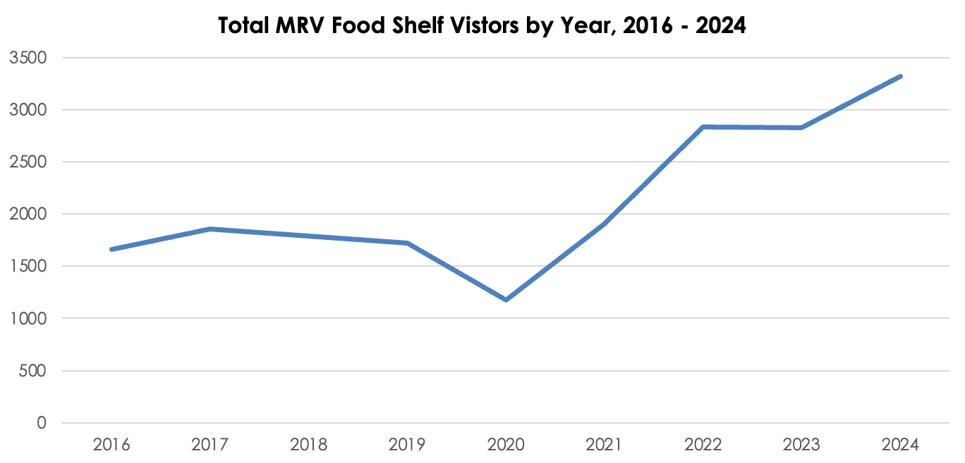
Annual visits to the MRV Community pantry: increased by over 1,500
Visits increased by 182% between 2020 and 2024
Figure 15, page 21

Slide 26
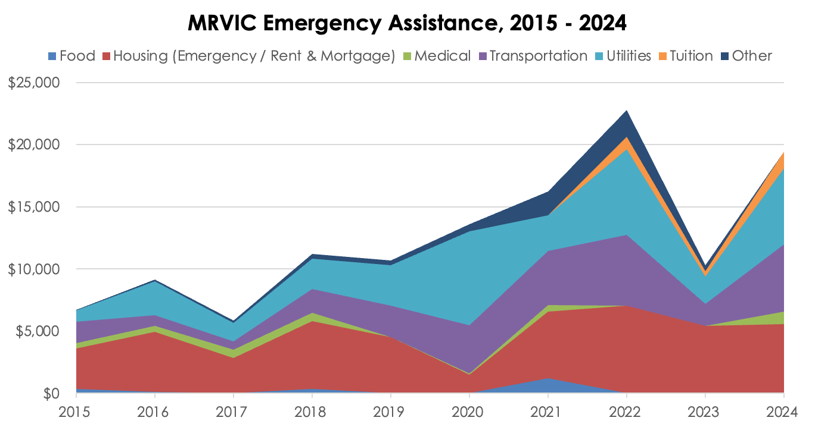
The MRVIC dispersed $19,440 in 2024 - 88% than 2023; 55% higher than average ($12,559)
Figure 16, page 22

Slide 27
2019 - 2024: Calls to…
Ambulance Dept. increased by 29%
Fire Dept. increased by 56%,
Total MRV Emergency service calls increased by 36%
Figure 68, page 79
Notes:
Maybe make a crime slide…

Slide 28
Average annual ridership: 50,832
2021-2025: bus ridership rebounded to pre-pandemic levels (+237%)
2023-2024: total ridership rose an additional 25%.
Figure 67, page 78

Slide 29

Environment – Recent Trends
Total energy usage is up, slight downturn in 2023
Sugarbush Resort’s Annual Energy Usage has decreased
Land conservation is increasing
Trail use still decreasing from 2020 surge, trending towards stabilization

Slide 30
2018-2022: total electrical energy usage increased by 19%; down 1% between 2022-2023
Residential = 53%; Warren has highest proportion of energy use
Sugarbush Annual Energy Usage has decreased by 38% since 2002
Figure 71, page 82

Slide 31
MRV has increased conserved land by 1,600 acres
As of 2021: 36% of Warren is conserved, compared to 27% of Fayston and 17% of Waitsfield
At the municipal level, Waitsfield has the most land conserved (798 acres), compared to Fayston (105) and Warren (244)
Figure 76, page 91

Slide 32
Trail counts: MRVPD partnership with CVRPC, bi-yearly trail counts between August and October, weather fluctuations, event fluctuations
Decrease from trail-use boom in 2020, trending towards stabilization
“Remote trails” vs “Town Trails” – both see fluctuations in use over time
Figure 53, page 60
Notes:
Condense here…CVRPC, collaboration, bi-yearly data collection on trails in MRV. 2 week counts, same methodology. Weather fluctuation.

Slide 33

History of MRV Wellbeing Survey
Years administered: 2021, 2022, 2024, 2026
MRV Community Indicator Project:
MRV Data Report, Dashboard
Develop goals, track progress towards vision statement
Strengthen community dialogue

Slide 34
MRVPD Vision Statement:
“The Mad River Valley is an innovative, vibrant, connected, and caring community honoring its past, celebrating its landscape, and actively pursuing its potential.”
MRVPD Data Report quantifies
Population, Social Services, Housing
Tourism, Hospitality, Retail
Industries, Employment, Unemployment
Traffic, Transit
Emergency services, Crime
Energy, Water quality, Conservation
Wellbeing Survey explores the quality of
Life satisfaction Governance
Psychological & Physical Health Work Life
Social Connectedness Material Wellbeing
Community Vitality Perceived Strengths
Time Balance Perceived Challenges
Education & culture Desired Changes

Slide 35
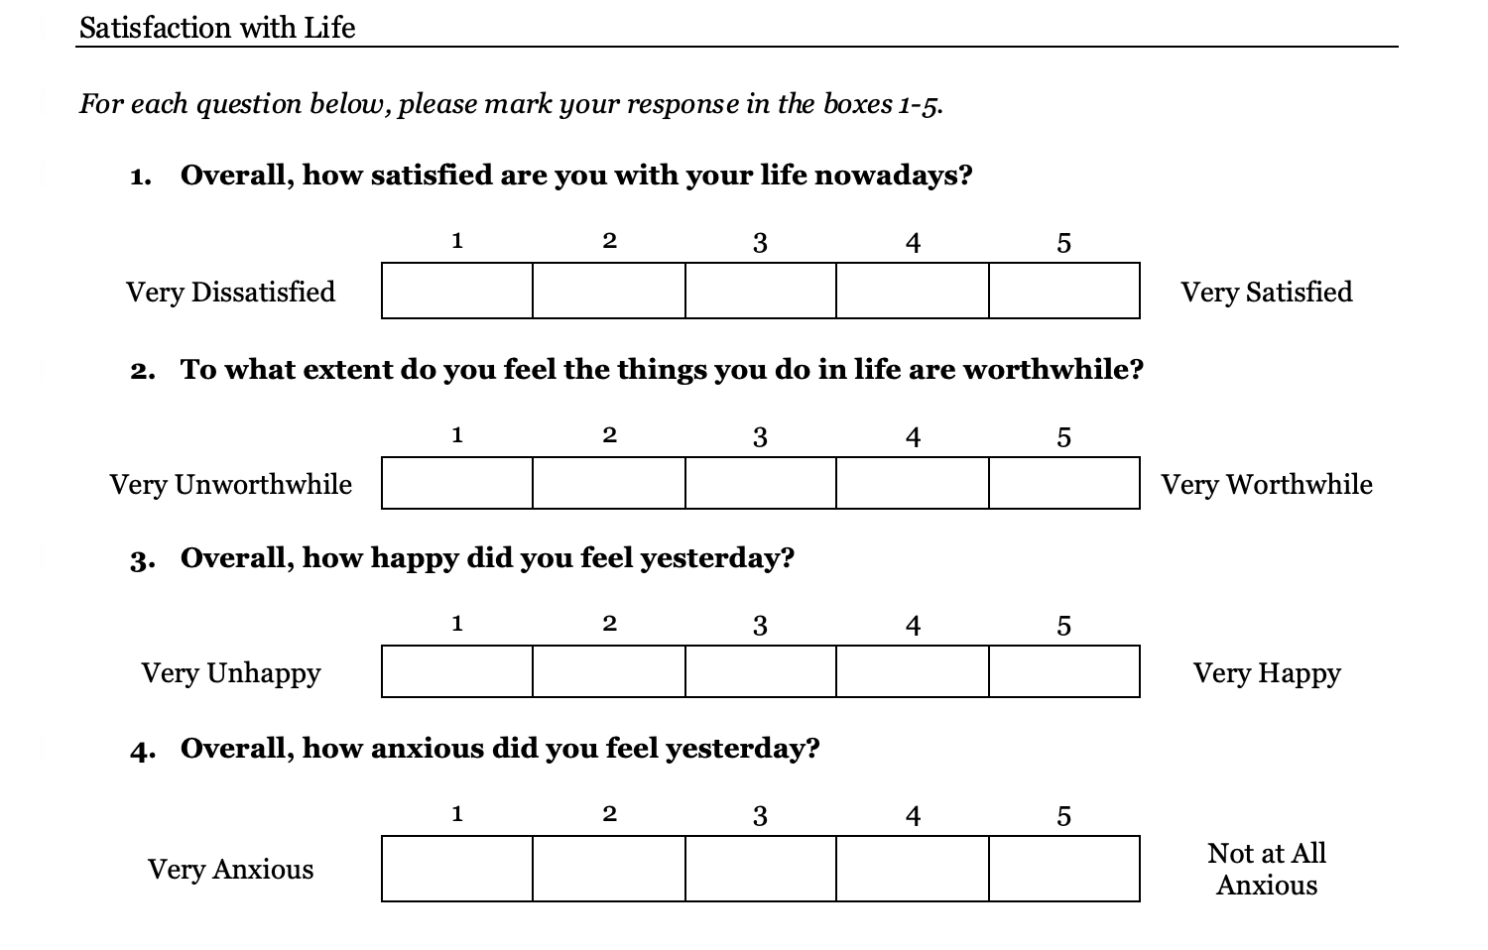
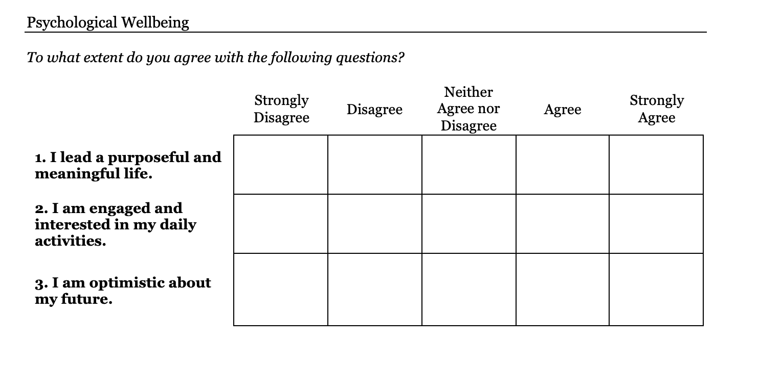
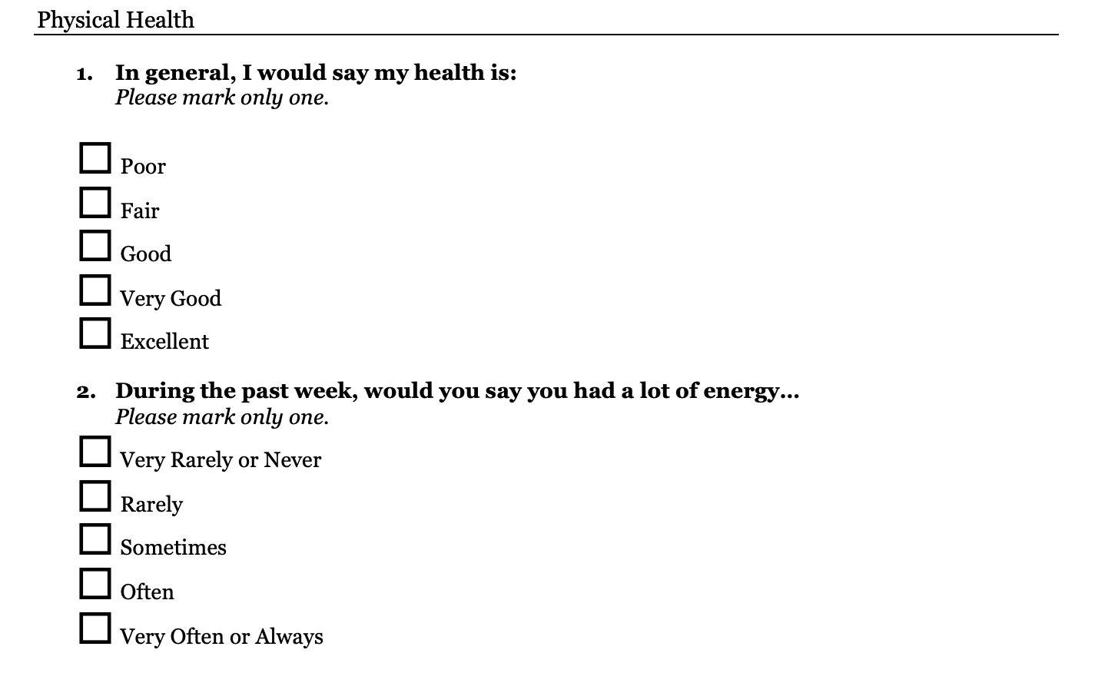
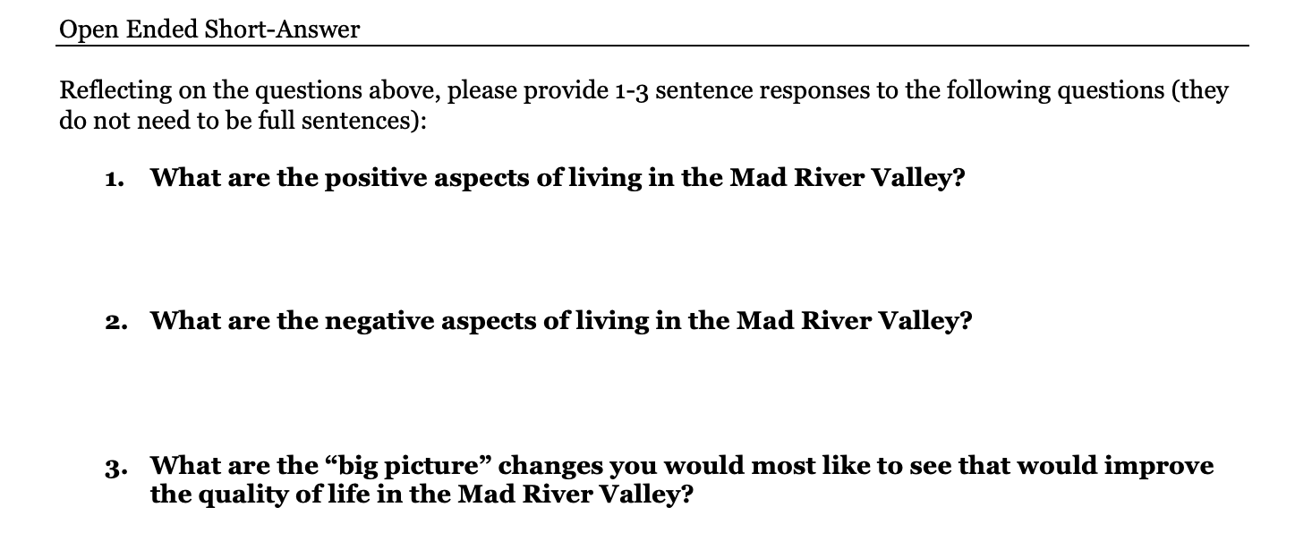

Slide 36
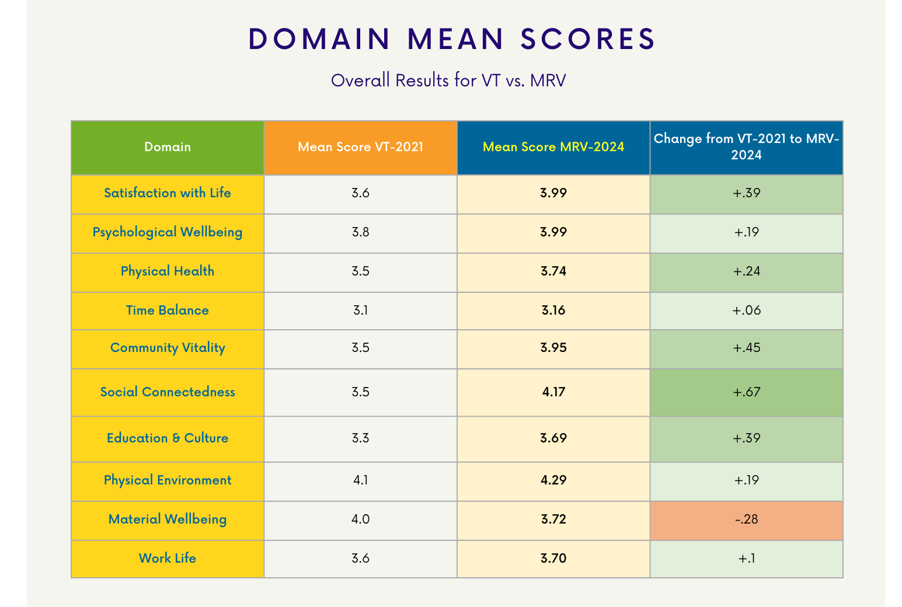
VT Data is from the VT Happiness Study

Slide 37
Wellbeing Survey Administration
May - June
Kick Off: Green Valley Rally
Town Offices, Libraries, MRVPD office
Online Distribution
Help us!
Take the survey & share with your network

Slide 38
Questions?
Thank you!

